Slide 1
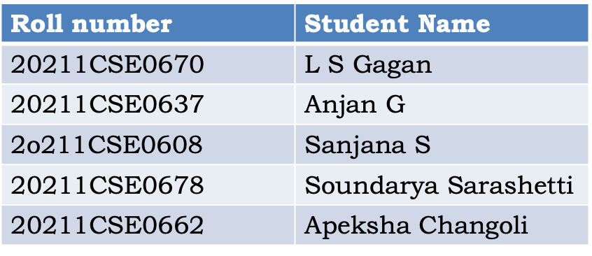
PIP104 CAPSTONE PROJECT
VIVA-VOCE
“ONE STOP SOLUTION FOCUSING ON TOURISM”
Under the Supervision of,
Mr.Syed Mohsin Abbasi
Professor
School of Computer Science & Engineering
Presidency University

Slide 2
Introduction
In today's world people travel a lot to different cities and countries . But it is hard for them to to travel in the city without prior knowledge.This is the prior motive behind making this app. A lot of websites and apps exist that do the similar job. An app exists
that can book hotels , another for booking cabs , another for booking shows , events etc but what we want to do is to integrate all of this into one app in order to save time of the user. Similar apps do exist but they are not very efficient and are very time
consuming . We aim to build an app that is user friendly and easy to use and will help people find out what they are looking for in a easier and time efficient way.

Slide 3
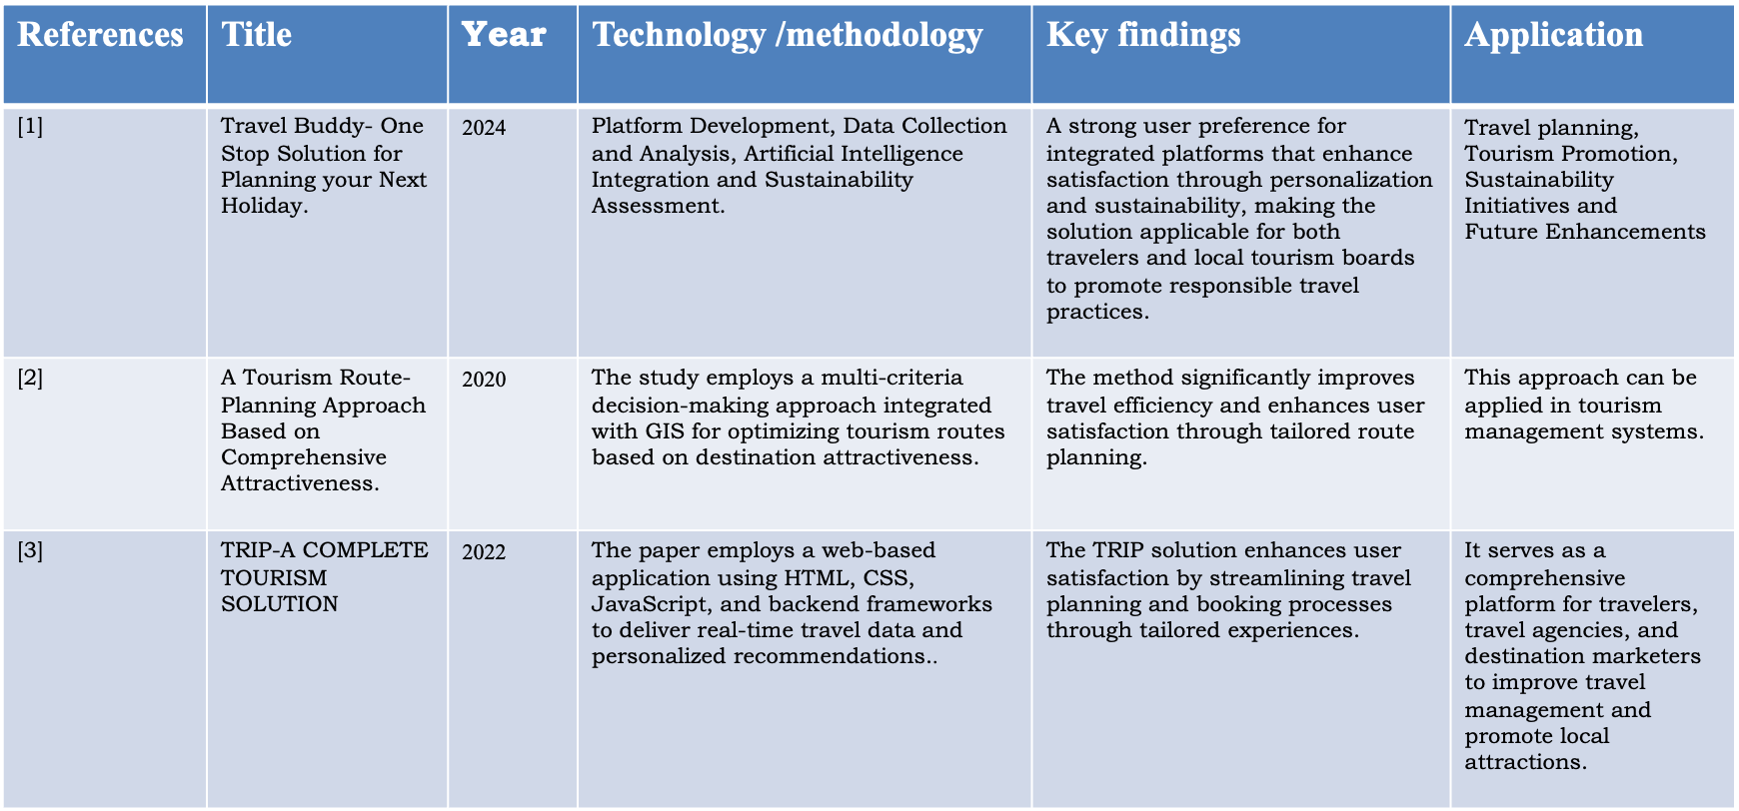
Literature Review

Slide 4
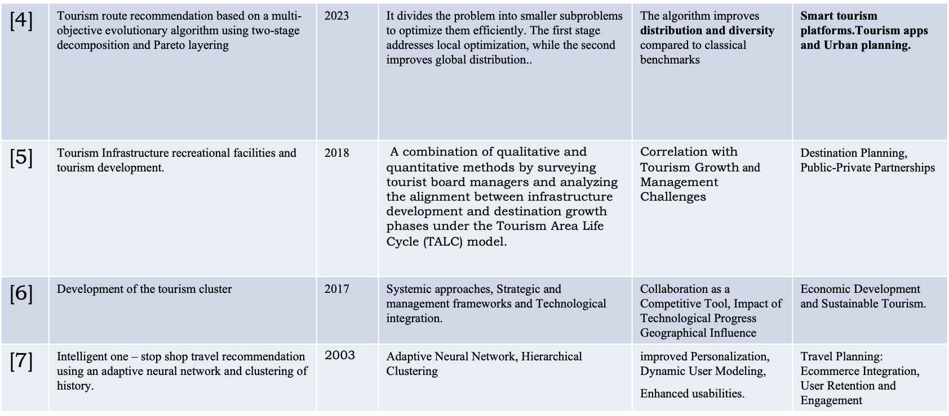

Slide 5
Proposed Methodology
Requirement Analysis
Objective: Identify the needs and pain points of travellers and stakeholders in the tourism ecosystem (travel agencies, local guides, accommodation providers).
System Design and Architecture
Objective: Establish a scalable, robust architecture for the platform.
Data Collection and Management
Objective: Aggregate comprehensive tourism-related data for seamless user experience.
User Experience (UX) and User Interface (UI) Design
Objective: Develop an engaging, user-friendly design that enhances user interaction and retention.

Slide 6

SDG Mapping
The project work carried out here is mapped to SDG-9 Industry, Innovation, and Infrastructure.
The project focuses on fostering innovation and building resilient infrastructure to support sustainable industrialisation. It aims to promote technological advancements and efficient resource management, enabling economic growth while minimising environmental impact.

Slide 7
System Design & Implementation
Data Flow Diagram (DFD)
User Interaction: Users interact with the system via web or mobile interfaces.
Data Input: Searches, booking details, user preferences, and feedback.
Data Processing: Backend logic processes input for personalized recommendations, itinerary planning, and booking confirmations.
Data Output: Display of search results, booking confirmations, and itinerary recommendations.
API Design and Integration
External APIs: Internal APIs:
Flight and hotel booking User management and authentication API.
Map services Recommendation engine API.
Payment gateway Booking management API.

Slide 8
Implementation Details
Frontend Development:
Tools & Frameworks: HTML and CSS for responsive design.
Features: User-friendly interfaces, search functionalities, booking forms, and itinerary displays.
Backend Development:
Tools & Frameworks: MySQL for storing, and querying structured data efficiently
Security Measures: Hashing for enhancing security, data integrity
Testing and Quality Assurance
Types of Testing:
Unit testing for individual components.
Integration testing for APIs and third-party services.
Security testing to safeguard user data.

Slide 9
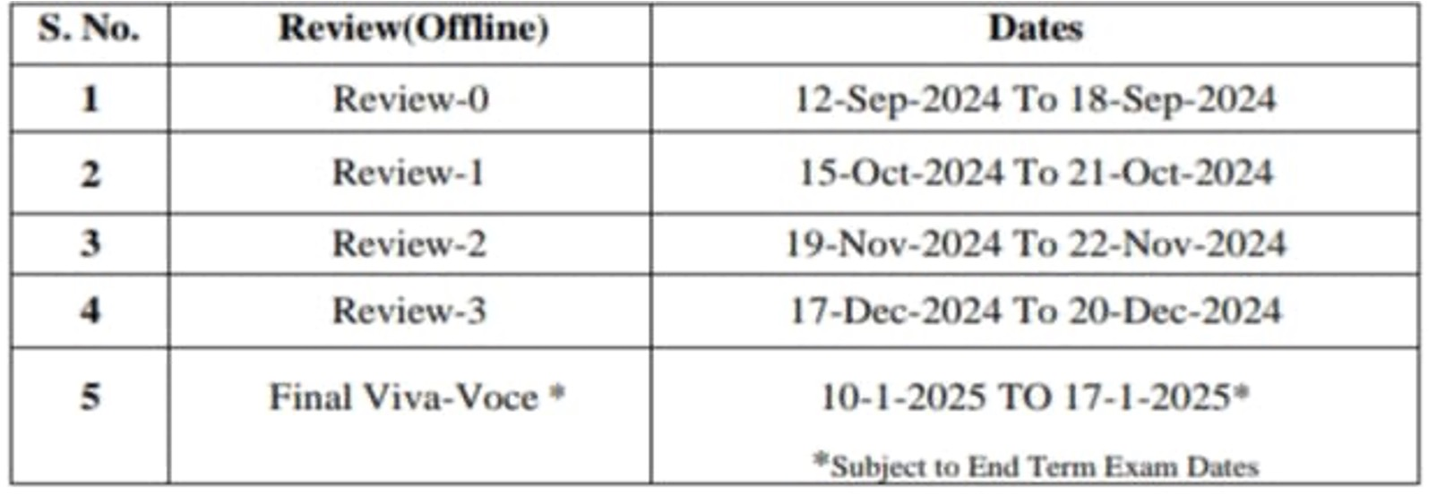
Timeline of Project

Slide 10
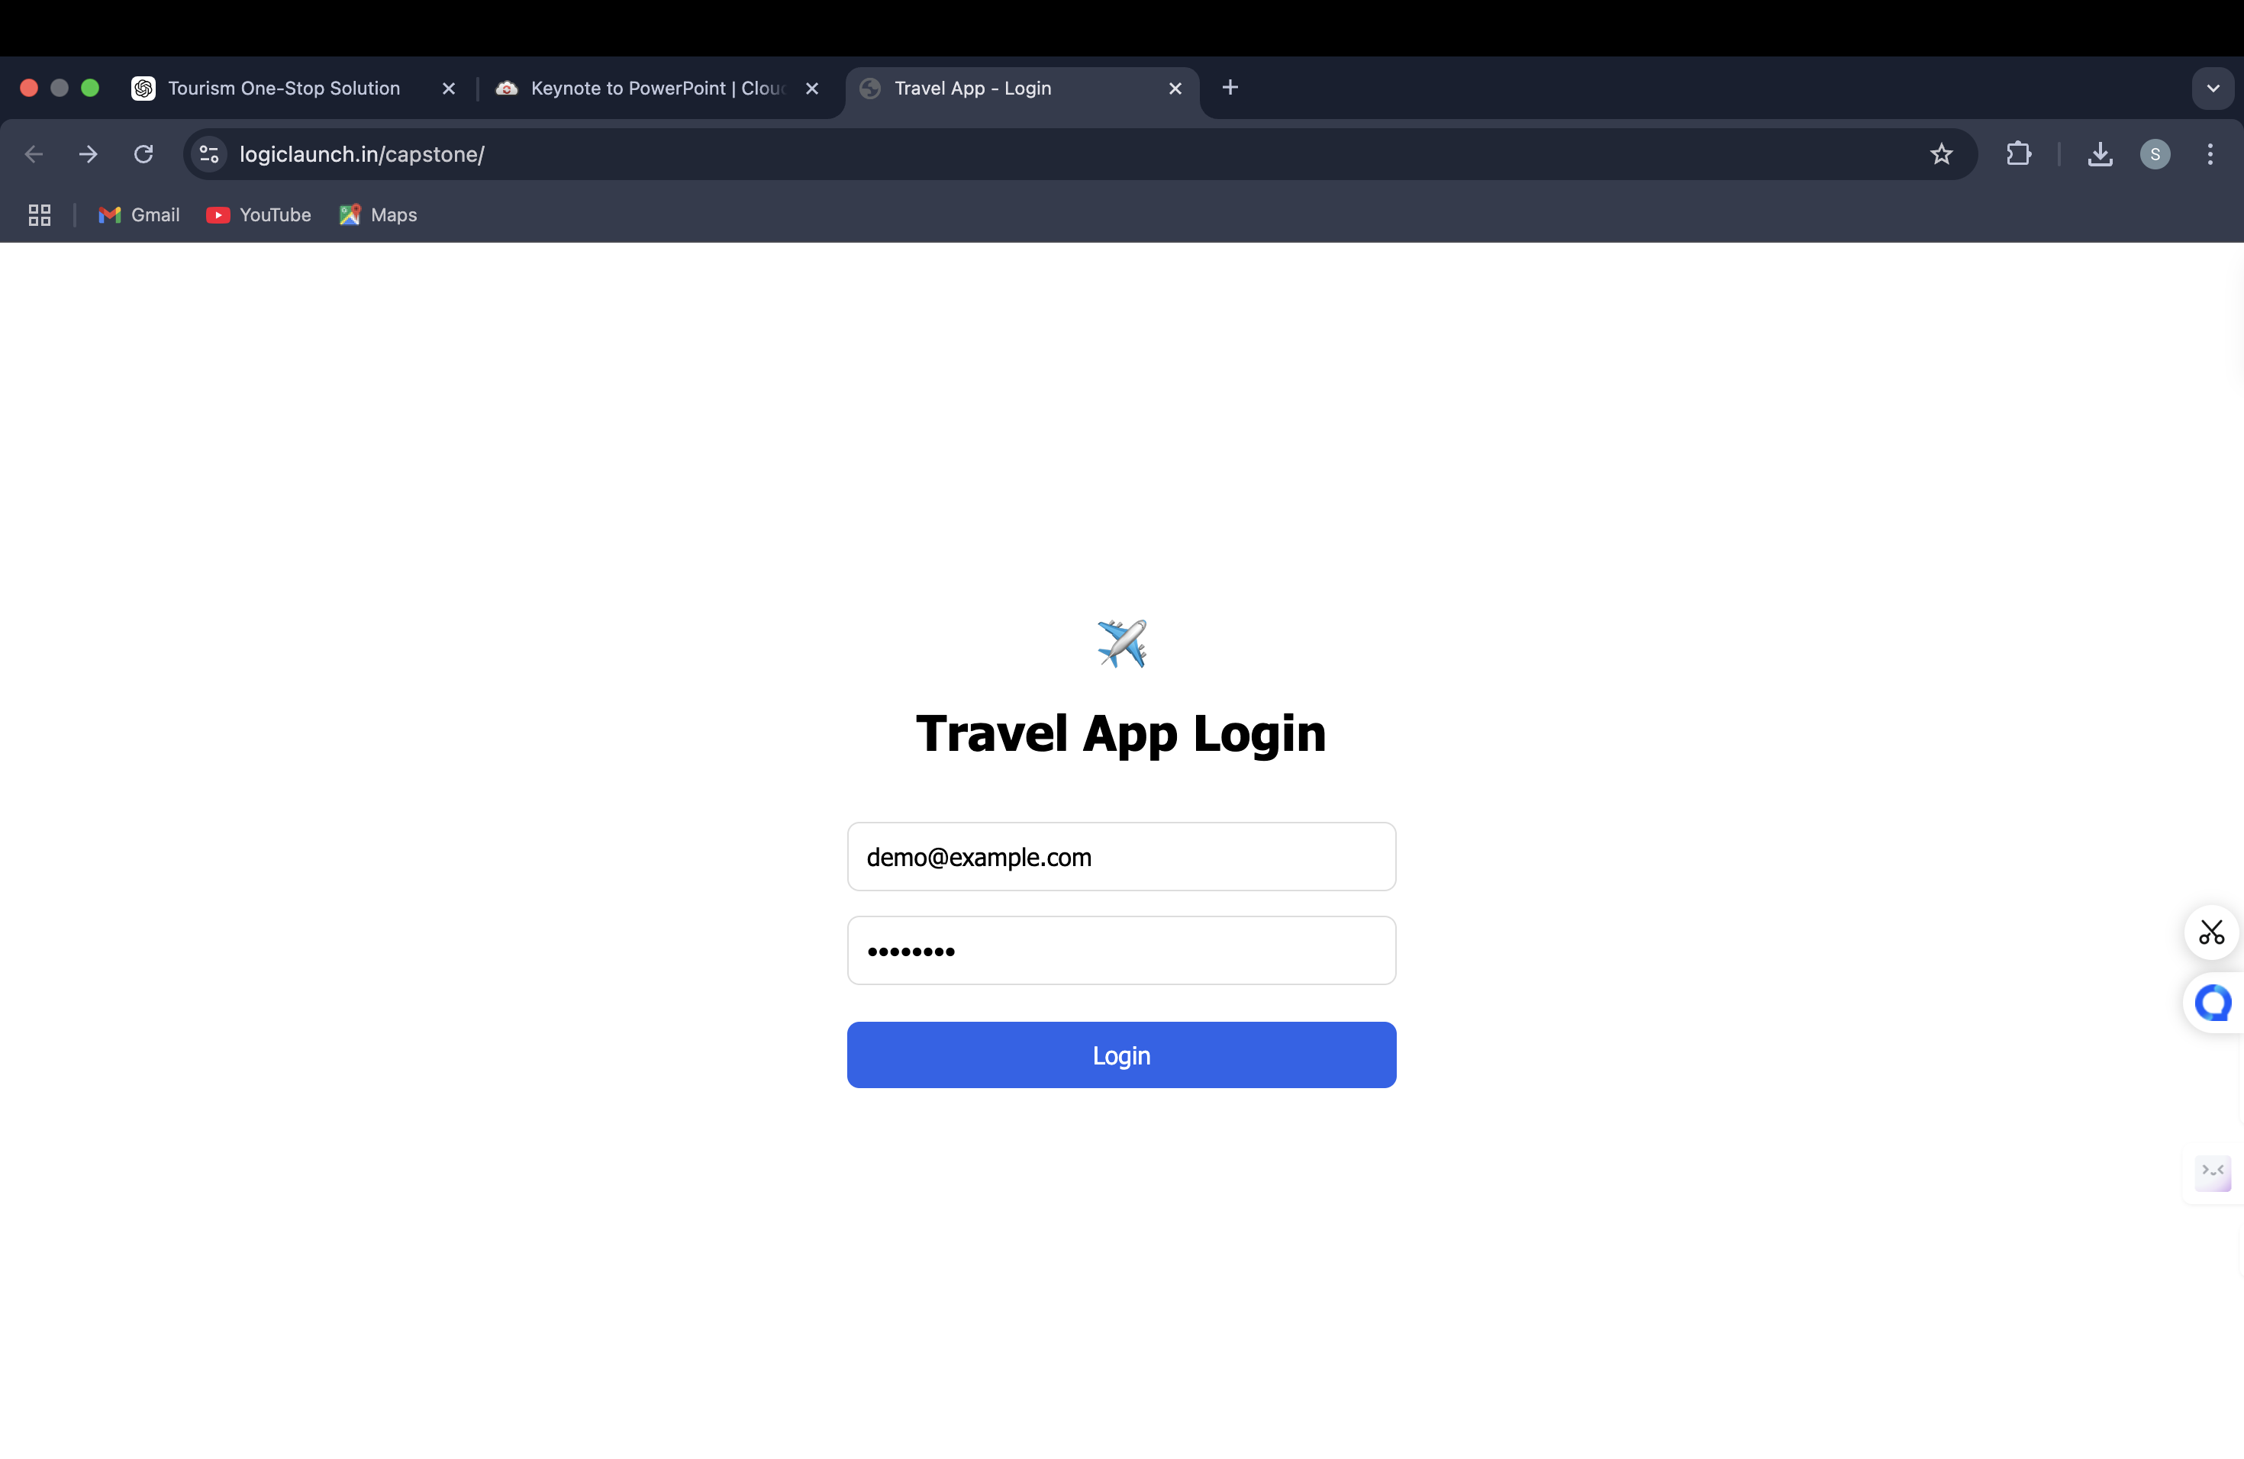
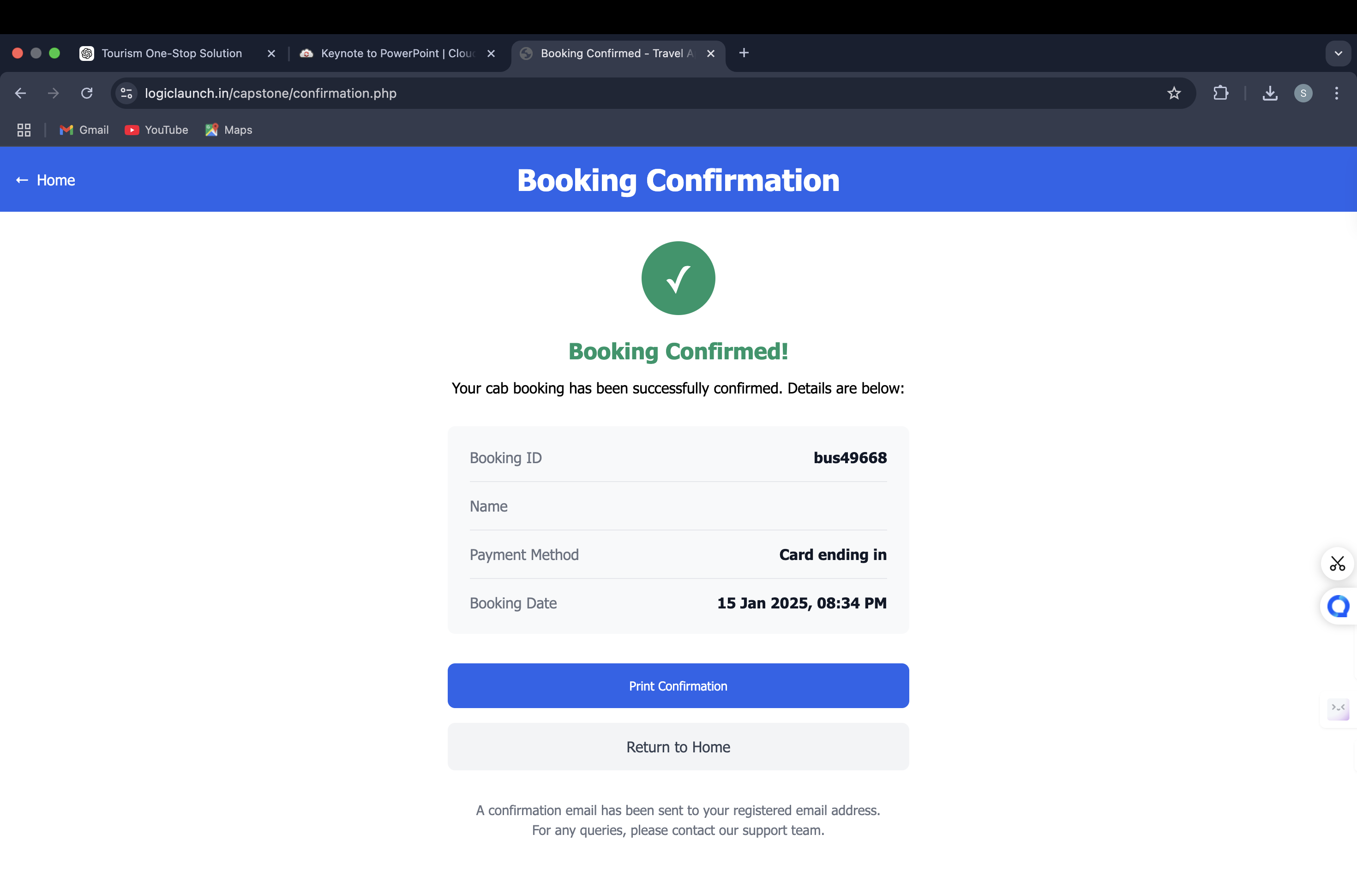
Outcomes / Results Obtained

Slide 11
Conclusion
Innovative: The project integrates diverse travel services seamlessly.
Efficient: Streamlines trip planning and management.
User-Centric: Prioritises personalised recommendations and experiences.
Secure: Ensures data privacy and transaction safety.
Scalable: Adapts to growing user demands and evolving trends.
Collaborative: Fosters community engagement and user contributions.
Reliable: Delivers accurate, real-time information and support.
Comprehensive: Offers a one-stop solution for all travel needs.

Slide 12
References
[1]. A. Maheshwari and A. K. Sahoo, "Travel Buddy- One Stop Solution for Planning," INTERNATIONAL JOURNAL OF ENGINEERING RESEARCH & TECHNOLOGY (IJERT), vol. 13, no. 05, May 2024.
[2]. Y. Zhang, L. Jiao, Z. Yu and Z. L. a. M. Gan, "A Tourism Route-Planning Approach Based on Comprehensive Attractiveness," IEEE Access, vol. 8, pp. 39536-39547, 2020.
[3]. Chauhan, A. a. Gupta and R. a. Singh, "Trip-A Complete Tourism Solution," Proceedings of the Advancement in Electronics & Communication Engineering, 2022.
[4]. X. Y. Zheng, B. T. Han and a. Z. Ni, Tourism route recommendation based on a multi-objective evolutionary algorithm using two-stage decomposition and Pareto layering, vol. 10, 2023., p. 486–500.
[5]. A. Mandić, Ž. Mrnjavac and L. Kordić, TOURISM INFRASTRUCTURE, RECREATIONAL FACILITIES AND TOURISM DEVELOPMENT, vol. 24, 2018.
[6]. Margarita Boiko (Ukraine), M. B. (2017). DEVELOPMENT OF THE TOURISM CLUSTER (Vol. 14).
[7]. WALLACE, M., MAGLOGIANNIS, I., & KARPOUZIS, K. (2003). INTELLIGENT ONE-STOP-SHOP TRAVEL RECOMMENDATIONS USING AN ADAPTIVE NEURAL NETWORK AND CLUSTERING OF HISTORY (Vol. 6).

Slide 13
PROJECT GITHUB LINK:
https://github.com/Soundaryasarashetti/A-one-stop-solution-focusing-on-
tourism.git

Slide 14
Thank You

